Slide 1
Find Travel insurance plan for students
Mind Map Orbs

Slide 2
Team members
1.Sai Srujana Ravipati (911639 )
2.Wadgave Sangmesh (911358)
3.Ranabothu Varshitha Reddy (911079)
4.Dereddy Nikhitha Reddy (911637 )
5.Shiva Sharma (911593)

Slide 3
Description
Find travel insurance plan for students, for 2 people (Age 22 & 21) & any European country, fill further dummy details & display three lowest international travel insurance plan with amount and insurance provider company.
Get a Car insurance quote, proceed without car number, keep filling details, give invalid email or phone number & capture the error message.
Retrieve all Health insurance menu items and store in a List; Display the same.
(Suggested site:
policybazaar.com however you are free to use any other legitimate site)

Slide 4
Key Automation scope:
1.Handling alerts, search option
2.Validation of date controls
3.Filling simple form, Capture warning message
4.Extract menu items & store in collections
5. Navigating back to home page

Slide 5
Travel insurance:
Open Url: www.policybazaar.com
Click the travel insurance icon
Enter the necessary details
Click on add travelers
Enter the mobile number and click on proceed
Click the student check box and enter the details as per the instruction in the description
Sort the price as low to high and display the top 3 insurance providers

Slide 6
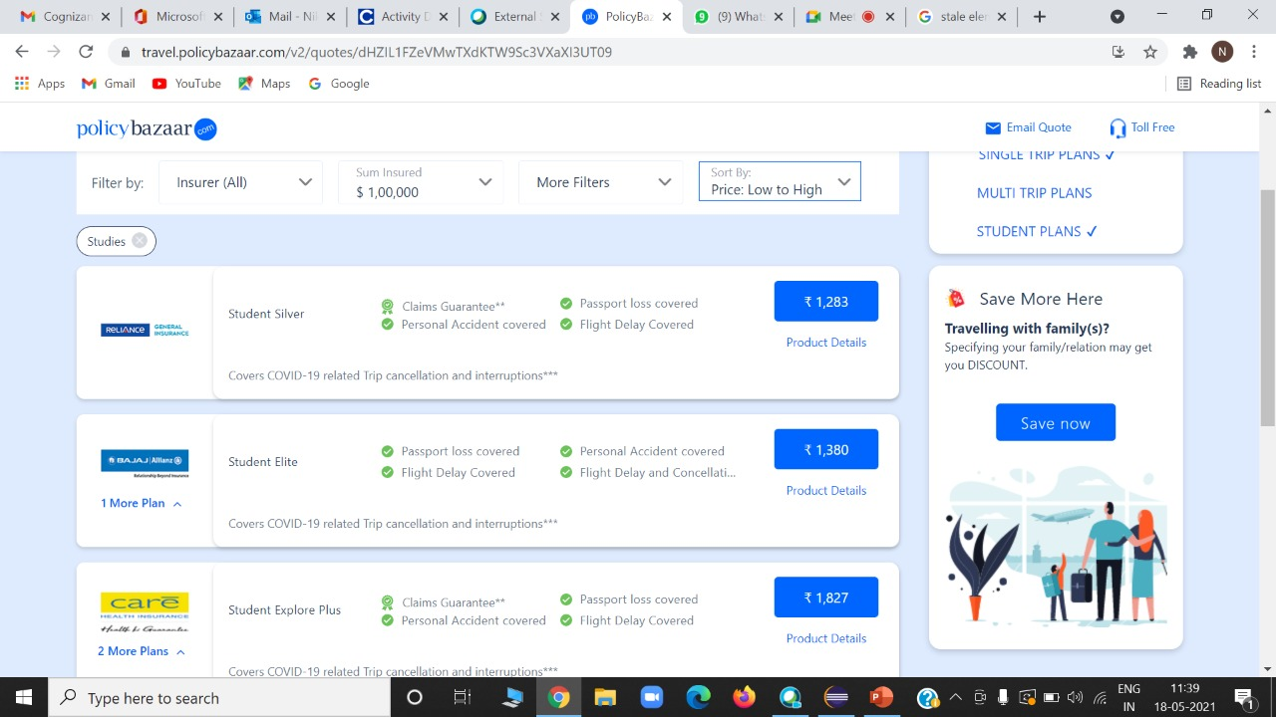

Slide 7
Car Insurance
Click the Car Insurance icon.
Continue without car number.
Enter the car details.
Enter the name, invalid email-id or phone number.
Get a screenshot of error message.

Slide 8
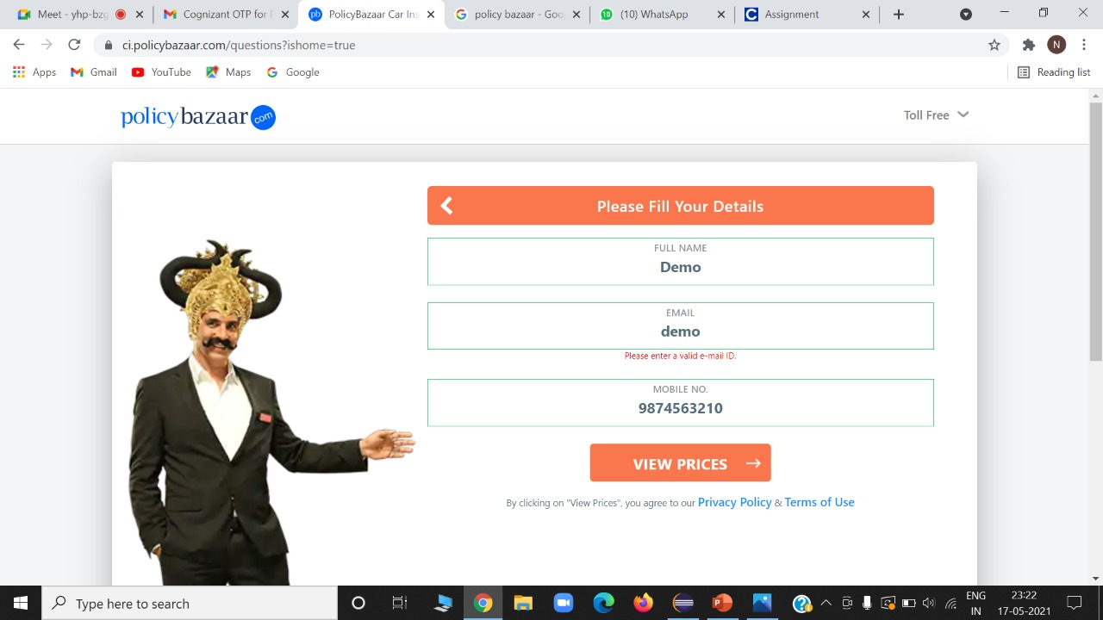

Slide 9
Health Insurance
Click the insurance products.
2. Then just display the list of health insurance.

Slide 10
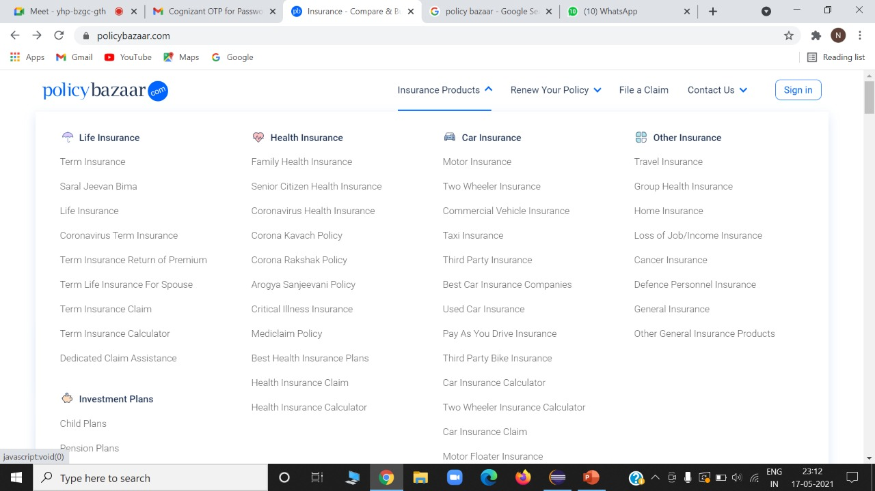

Slide 11
Thank you!

